Slide 1

Dictionaries
(also mentioned in your textbooks p80)
You will find this feature useful for your CA

Slide 2
Lists or Dictionaries?
If you want a data structure to hold numerous items in order, use a LIST.
But sometimes, the order of entry is not important. In fact, at times, you might face a situation in which you want a mapping from Keys to Values. A classic example is when you are using a telephone book to look up a name (Key) to find an associated phone number (Value).
(Yes, the telephone book may be in alphabetical order, but that isn’t as important as the mapping of Keys to Values)

Slide 3
When we have this situation…
Examples of Key to Value mapping
Eg.1 ‘Hola’ : ‘Hello’
Eg.2 ‘OR’ : ‘Oregon’
‘FL’ : ‘Florida’
‘CA’ : ‘California’
‘NY’ : ‘New York’
Eg.3 ‘A*’ = 10
‘A’ = 8
‘B’ = 6
‘C’ = 5
We find that the dictionary data structure is very useful.

Slide 4
So, to understand dictionaries, you must accept the KEY:VALUE concept.
In Python, we can set up our own dictionary like this…
domain_dictionary= {
‘UK’: ‘United Kingdom’ ,
‘IE’ : ‘Ireland’ ,
‘ES’: ‘Spain’
}
Key
Value

Slide 5
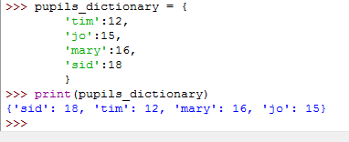
Note the following…
Remember that the entries in the dictionary are unordered, as you can see above.

Slide 6
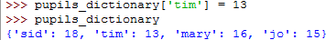
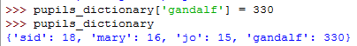
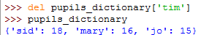
To edit & insert an entry in the dictionary…
dictionary_name[KEY] = new_entry
To delete an entry in the dictionary, you use the delete function.
del dictionary[KEY]

Slide 7
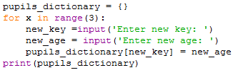
Adding new entries to the dictionary using FOR loop…

Slide 8
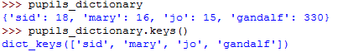
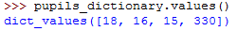
Some important ( & useful) things to remember when
working with dictionaries…
dictionary.keys()
This will give you a list of the keys…as a list.
{Note the dictionary brackets}
(Note the list brackets)
Likewise, we can get a list of the values…as a list.
dictionary.values()

Slide 9
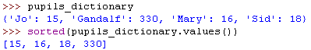
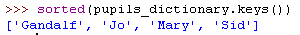
Perhaps you may at some point decide that you want
to SORT a dictionary. Well, this is possible using the sort method.
Let’s sort out our list by looking at the VALUES… sort dictionary by value.
sorted(pupils.dictionary.values())
Let’s sort out our list by looking at the VALUES… sort dictionary by value.
We can also sort by the KEYS…
sorted(pupils.dictionary.keys())

Slide 10
Let’s say we have an external file (☺)… and we want to import data from the external file into a dictionary. How is this achieved?
my_dictionary = {
‘A’:1,
‘B’:2,
‘C’:3,
‘D’:4,
.
.
.
‘Y’:25,
‘Z’:26
}
A1
B2
C3
D4
E5
.
.
.
Y25
Z26
into
key.txt
program

Slide 11
Notice that the key’s file contains data in the form…
A1
B2
C3
..
To access each line and output to our screen, use this…
for line in file_keys:
print(line)
A1
B2
C3
Next, notice that we can individually access each character on a line by using an index.
A 1
for line in file_keys:
print(line[0])
A
B
C
line[0]
line[1]
for example,

Slide 12
We can take advantage of this and split these two items into KEY : VALUE format for our dictionary…
A 1
line[0]
line[1]
:
KEY
VALUE
Finally, because our data is in the Key:Value form, we can use a method called update()which will update our dictionary with the new KEY and VALUE entry…
my_dictionary.update({line[0]:line[1]})

Slide 13
Hence, our solution looks like this.
def import_keys_to_dictionary():
my_dictionary = {} # initialise dictionary
file_keys=open(‘keys.txt','r') # open file path for reading.
for line in file_clues: # for each line in the file.
my_dictionary.update({line[0]:line[1]}) # update dictionary
file_keys.close() # save changes to file
return my_dictionary # the function returns the dictionary as a result.

Slide 14
Tasks
Create a simple dictionary data structure in Python, that accepts the following data- maximum temperatures (°C) ever recorded (per month) in Britain. Key is Month: Value is Temp.
e.g. January:18.3 February:19.7 March:25 …December:18.3
Create a simple dictionary data structure in Python, but this time, use a for… loop to prompt and accept the entries for the dictionary. The dictionary should store the minimum temperatures (°C) ever recorded in Britain (per month). Again, use Month as the Key and Temperature as the Value.
Find a text file called ‘code.txt’ in Fronter. Write a program that imports the data within code.txt to a dictionary.
Key (Name) : Value (Age)
‘Tom326’ should be stored as {'Tom': '326‘}
The program should then output the contents of the dictionary.

